Slide 1

Maroon Hacks
KWELYO

Slide 2
Income Distribution _{PSA}
Notes:
*-hanap assets/pictures
>-next slide
5 mins
2 mins intro
Do I start with a great Philippines?
*State ng education ng Philippines
*Only bla bla can go to school
*Only bla bla can finish high school
*Only bla bla can even go to college
Statistics/Demographics
GDP???
Poverty index
>
out if the total popn
>
freelancer, kalibrr, jobstreet
They try to reduce unemployment rates by being platform that provides jobs for seekers and employers alike

Slide 3
Income Distribution _{PSA}
Notes:
*-hanap assets/pictures
>-next slide
5 mins
2 mins intro
Do I start with a great Philippines?
*State ng education ng Philippines
*Only bla bla can go to school
*Only bla bla can finish high school
*Only bla bla can even go to college
Statistics/Demographics
GDP???
Poverty index
>
out if the total popn
>
freelancer, kalibrr, jobstreet
They try to reduce unemployment rates by being platform that provides jobs for seekers and employers alike

Slide 4
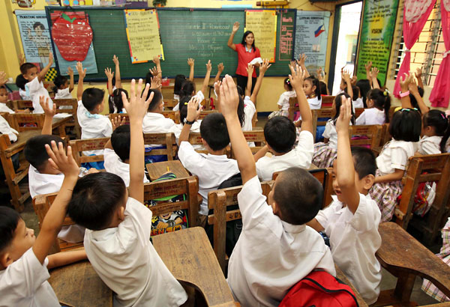
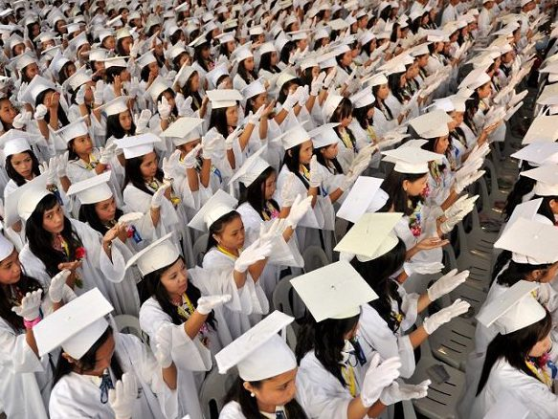
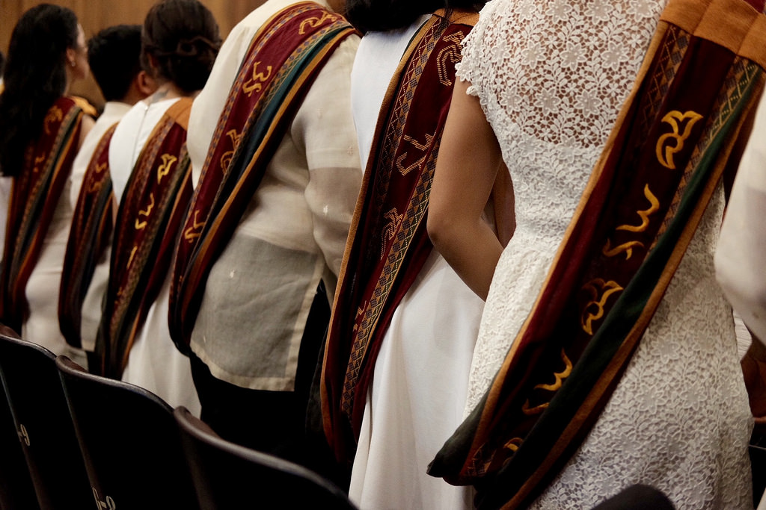
primary
secondary
tertiary
Notes:
*-hanap assets/pictures
>-next slide
5 mins
2 mins intro
Do I start with a great Philippines?
*State ng education ng Philippines
*Only bla bla can go to school
*Only bla bla can finish high school
*Only bla bla can even go to college
Statistics/Demographics
GDP???
Poverty index
>
out if the total popn
>
freelancer, kalibrr, jobstreet
They try to reduce unemployment rates by being platform that provides jobs for seekers and employers alike

Slide 5





Notes:
*-hanap assets/pictures
>-next slide
5 mins
2 mins intro
Do I start with a great Philippines?
*State ng education ng Philippines
*Only bla bla can go to school
*Only bla bla can finish high school
*Only bla bla can even go to college
Statistics/Demographics
GDP???
Poverty index
>
out if the total popn
>
freelancer, kalibrr, jobstreet
They try to reduce unemployment rates by being platform that provides jobs for seekers and employers alike

Slide 6
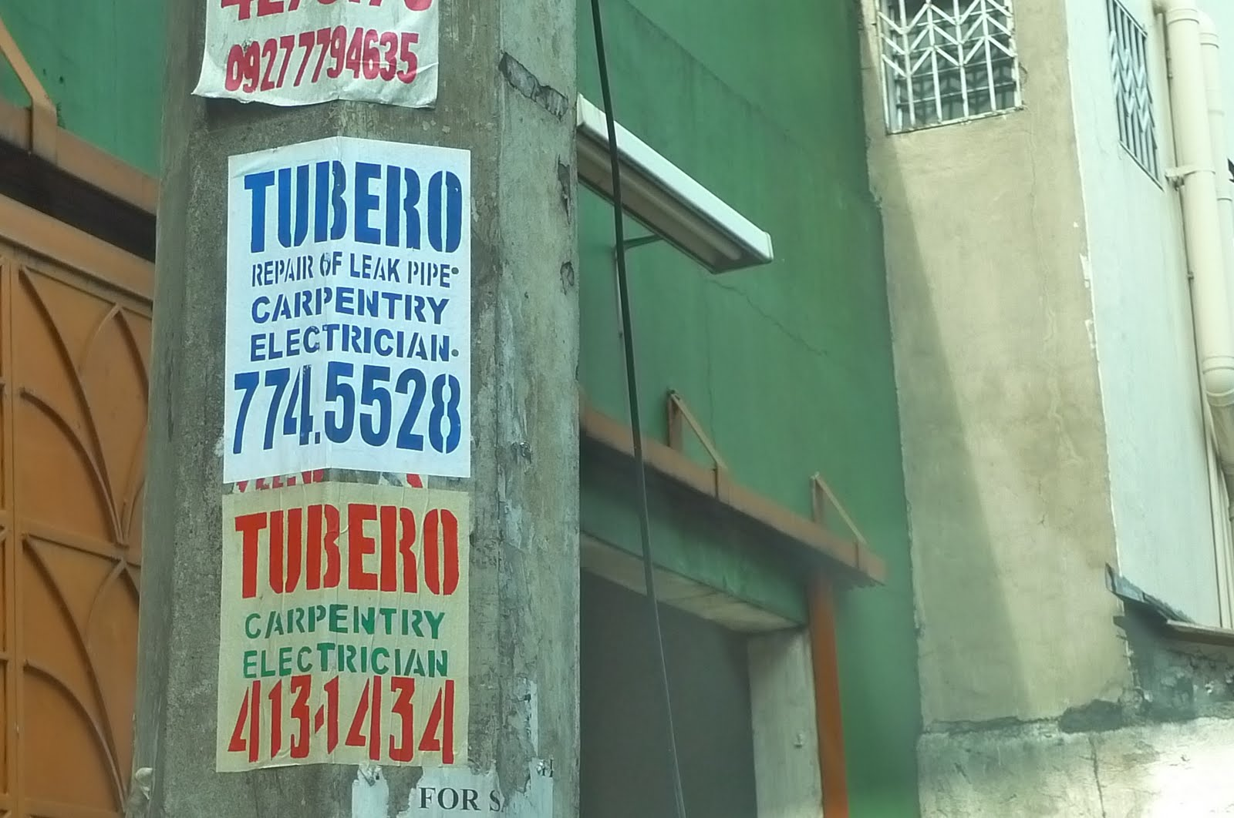
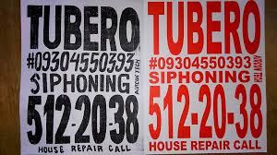
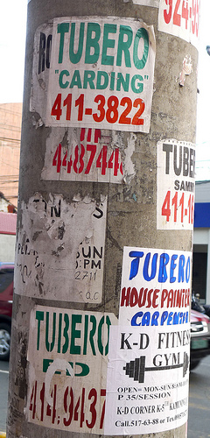

Notes:
*Paano na yung mga natira? Yung mga di nakapagtapos ng pag-aaral?
Why is it that (Mang Carding), despite having these online platforms, we still see posters like this?
>insert picture ng tubero postings,
why, in this digital age we live now, we still see posters like these around?
>It is because of the sad fact/hard truth that only 43.5% of Fili have access to the internet, insert graph
Sadly, sila yung mga nagiging following:
Tubero, carpenter, gardener, home repair, raketeros
Driver for long car rides (province or smth), Mason, electrician, Poso negro, washing machine, car mechanic, wood worker, furniture,
Mga napag-iwanan ng technology
There
Technological gap
Travel back in time, to be able to serve ung mga napag-iwanan/ closing the technological
Texting capital of the world
What do we do with them?
Empower them.
How? By making them productive.
How? By giving them job opportunites despite having limited/no internet access at all

Slide 7
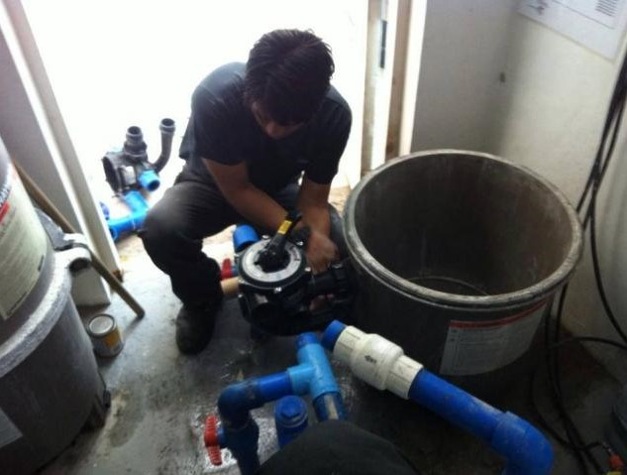
Tubero
Notes:
Insert Kwelyo
-an sms job service platform
-Connecting those with no/limited internet access to the world of internet
-labas ng kwelyo logo sa gitna then
Pictures ng workers sa gilid:
Then picture ng internete opportunities sa right

Slide 8
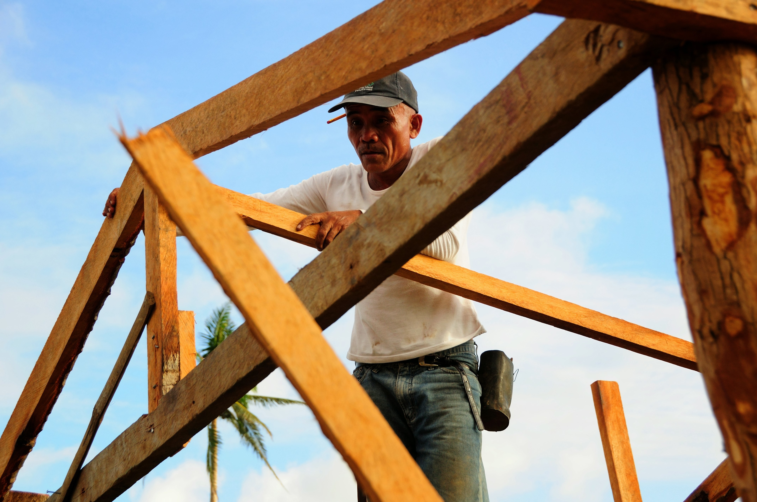
Karpintero
Notes:
Insert Kwelyo
-an sms job service platform
-Connecting those with no/limited internet access to the world of internet
-labas ng kwelyo logo sa gitna then
Pictures ng workers sa gilid:
Then picture ng internete opportunities sa right

Slide 9
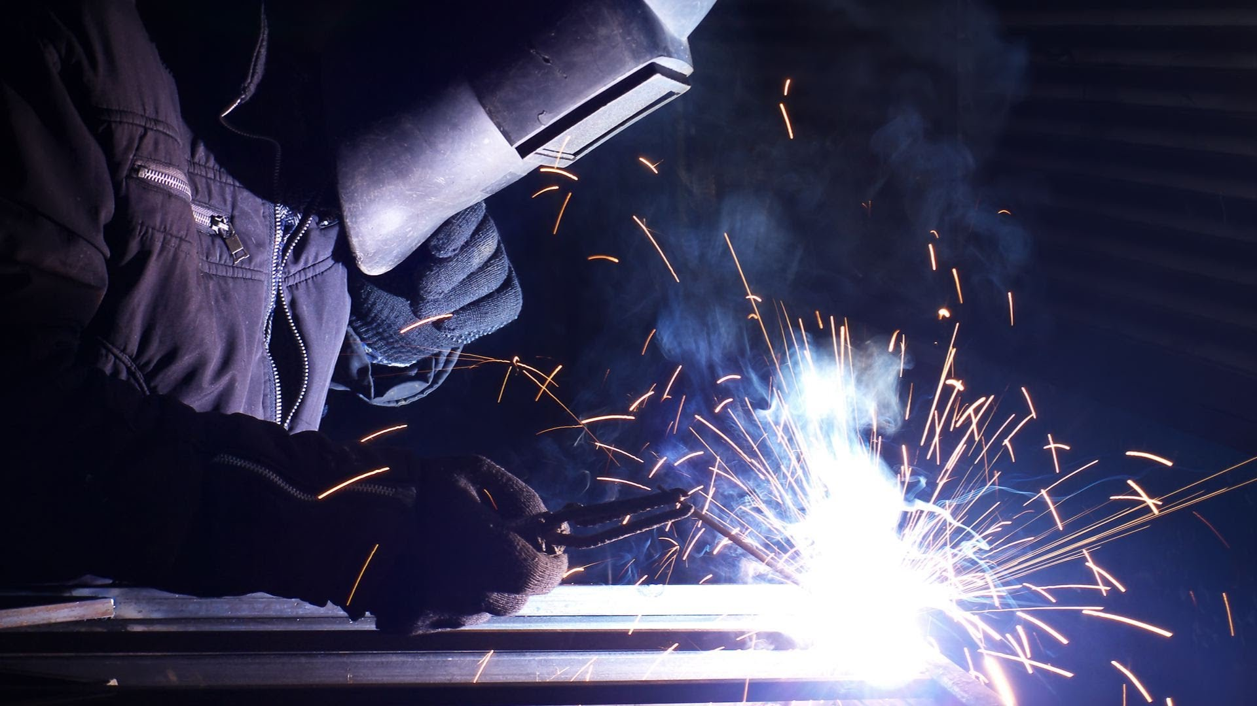
Welder
Notes:
Insert Kwelyo
-an sms job service platform
-Connecting those with no/limited internet access to the world of internet
-labas ng kwelyo logo sa gitna then
Pictures ng workers sa gilid:
Then picture ng internete opportunities sa right

Slide 10
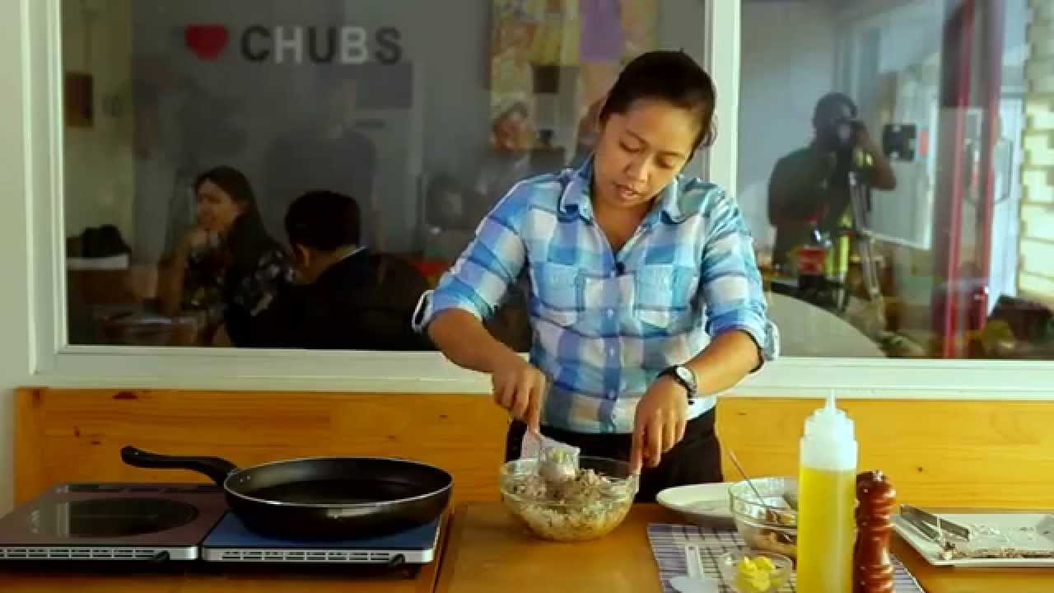
Kusinera
Notes:
Insert Kwelyo
-an sms job service platform
-Connecting those with no/limited internet access to the world of internet
-labas ng kwelyo logo sa gitna then
Pictures ng workers sa gilid:
Then picture ng internete opportunities sa right

Slide 11
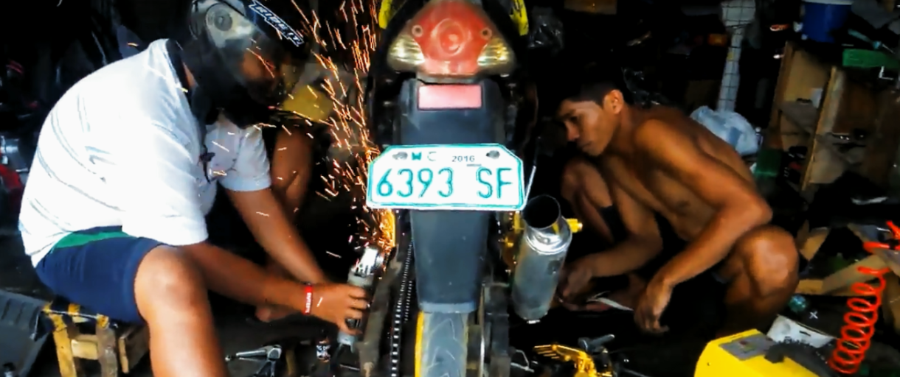

Mekaniko
Notes:
Insert Kwelyo
-an sms job service platform
-Connecting those with no/limited internet access to the world of internet
-labas ng kwelyo logo sa gitna then
Pictures ng workers sa gilid:
Then picture ng internete opportunities sa right

Slide 12
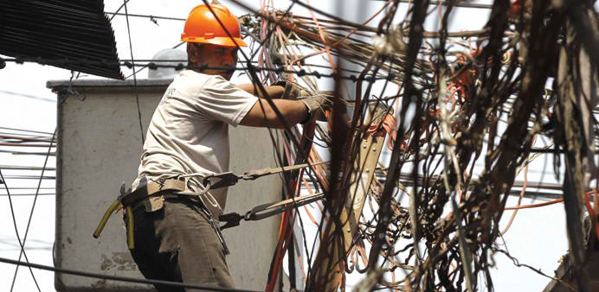
Electrician
Notes:
Insert Kwelyo
-an sms job service platform
-Connecting those with no/limited internet access to the world of internet
-labas ng kwelyo logo sa gitna then
Pictures ng workers sa gilid:
Then picture ng internete opportunities sa right

Slide 13
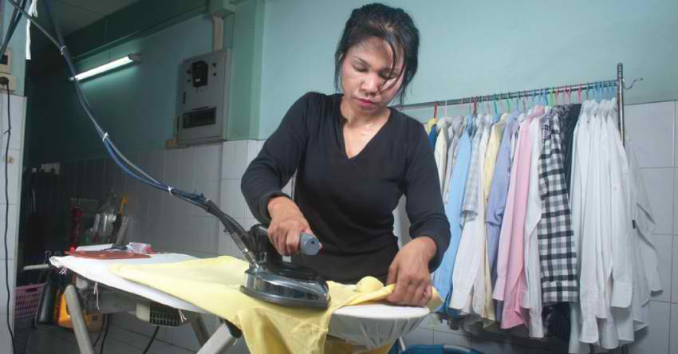
Kasambahay
Notes:
Insert Kwelyo
-an sms job service platform
-Connecting those with no/limited internet access to the world of internet
-labas ng kwelyo logo sa gitna then
Pictures ng workers sa gilid:
Then picture ng internete opportunities sa right

Slide 14
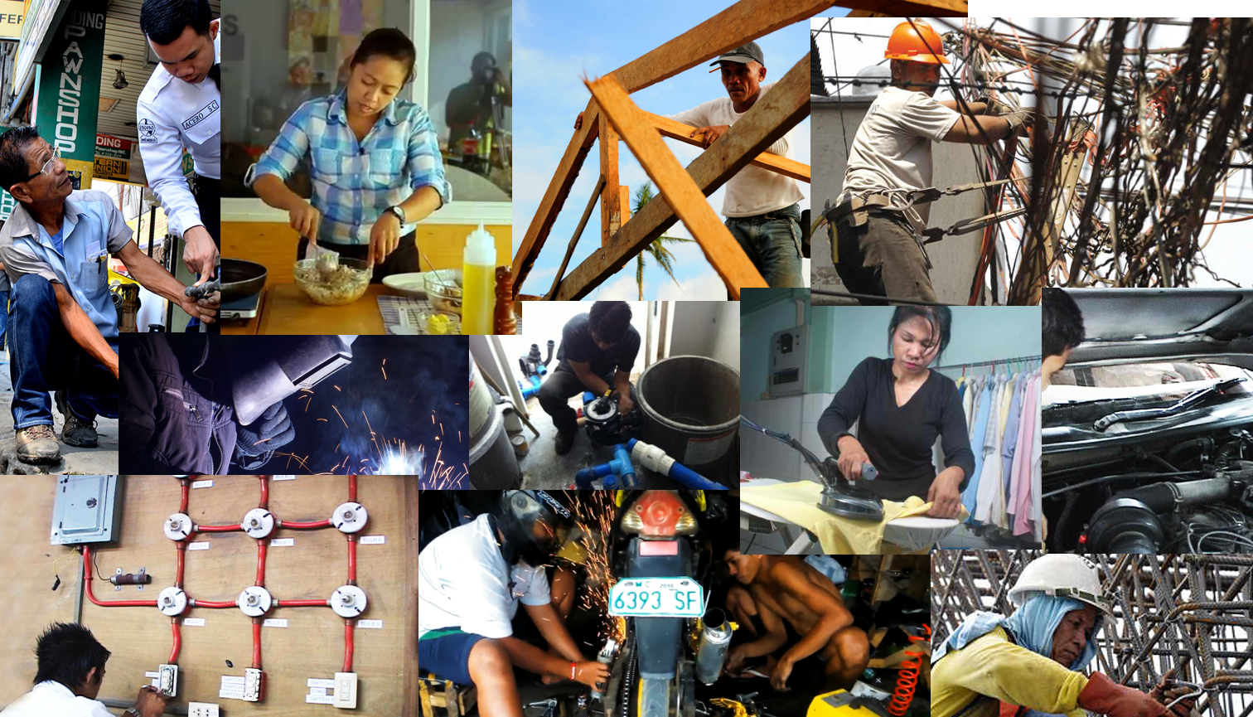
Notes:
Insert Kwelyo
-an sms job service platform
-Connecting those with no/limited internet access to the world of internet
-labas ng kwelyo logo sa gitna then
Pictures ng workers sa gilid:
Then picture ng internete opportunities sa right

Slide 15
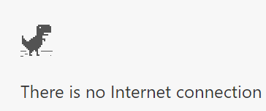
57 million
56%
out of 102 million Filipinos
LIMITED internet access
Notes:
As of 2016, the Philippines’ Internet User Penetration is only 43.5%
Meaning the other 56.5% or the 57 771, 325 out of the 102, 250, 1333 have limited access to the internet or do not have access to the internet at all/
So how can we address this problem?
By empowering our less pir
Source: http://www.internetlivestats.com/internet-users-by-country/
http://www.dict.gov.ph/wp-content/uploads/2017/09/2017.08.09-National-Broadband-Plan.pdf

Slide 16
INCLUSIVE
SUSTAINABLE ECONOMIC GROWTH
Notes:
Insert Kwelyo
-an sms job service platform
-Connecting those with no/limited internet access to the world of internet
-labas ng kwelyo logo sa gitna then
Pictures ng workers sa gilid:
Then picture ng internete opportunities sa right

Slide 17
EMPOWER
Notes:
Insert Kwelyo
-an sms job service platform
-Connecting those with no/limited internet access to the world of internet
-labas ng kwelyo logo sa gitna then
Pictures ng workers sa gilid:
Then picture ng internete opportunities sa right

Slide 18
HOW?
Notes:
Insert Kwelyo
-an sms job service platform
-Connecting those with no/limited internet access to the world of internet
-labas ng kwelyo logo sa gitna then
Pictures ng workers sa gilid:
Then picture ng internete opportunities sa right

Slide 19
KWELYO
making job opportunities accessible for everyone
Notes:
Insert Kwelyo
-an sms job service platform
-Connecting those with no/limited internet access to the world of internet
-labas ng kwelyo logo sa gitna then
Pictures ng workers sa gilid:
Then picture ng internete opportunities sa right

Slide 20

KWELYO
-an sms-based job service platform
“Bridging the technology gap,
one collar at a time.”
Notes:
Insert Kwelyo
-an sms job service platform
-Connecting those with no/limited internet access to the world of internet
Bridging the technological gap, one collar at a time
-labas ng kwelyo logo sa gitna then
Pictures ng workers sa gilid:
Then picture ng internete opportunities sa right

Slide 21

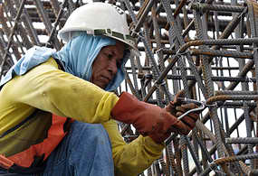
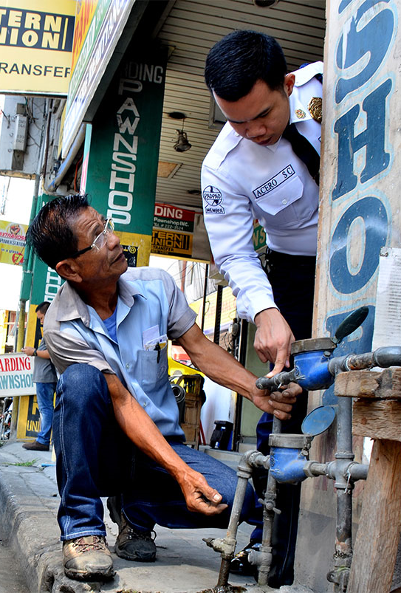
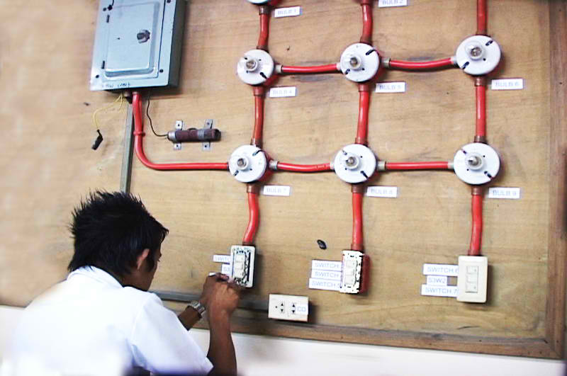
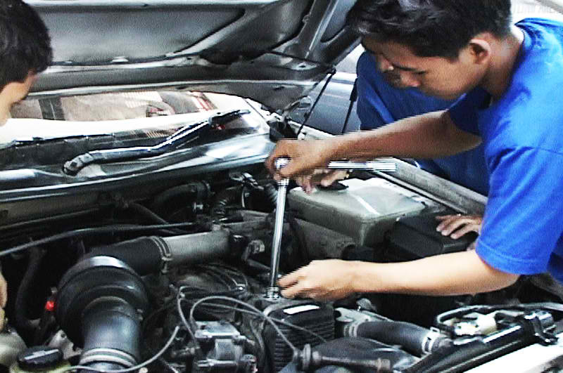
KWELYO
Notes:
Insert Kwelyo
-an sms job service platform
-Connecting those with no/limited internet access to the world of internet
Bridging the technological gap, one collar at a time
-labas ng kwelyo logo sa gitna then
Pictures ng workers sa gilid:
Then picture ng internete opportunities sa right

Slide 22
KWELYO
“Bridging the technology gap,
one collar at a time.”
Notes:
Insert Kwelyo
-an sms job service platform
-Connecting those with no/limited internet access to the world of internet
Bridging the technological gap, one collar at a time
-labas ng kwelyo logo sa gitna then
Pictures ng workers sa gilid:
Then picture ng internete opportunities sa right

Slide 23






Worker
Register
via sms
Verify your registration
Wait for a text or call from an employer
Notes:
*-hanap assets/pictures
>-next slide
5 mins
2 mins intro
Do I start with a great Philippines?
Statistics/Demographics
GDP???
Poverty index
>
*State ng education ng Philippines
*Only bla bla can go to school
*Only bla bla can finish high school
*Only bla bla can even go to college
>
*Paano na yung mga natira?
Sadly, sila yung mga nagiging following:
Tubero, carpenter, gardener, home repair, raketeros
Driver for long car rides (province or smth), Mason, electrician, Poso negro, washing machine, car mechanic, wood worker, furniture,
Sa mga natira,
*Only bla bla has access to the internet
>
*So what can we do for our lesser privileged brothers and sisters?
Show that education system is faulty at best, so habang inaayos pa yun, what we can do, right now is:
*To provide job opportunities to our lesser privileged brothers and sisters, especially those that have limited internet access or does not have access to the internet at all
*What comprises a nation? Nation building, building a nation (Dapat inclusive!!!)
2 mins demo
>1 min employer
>1 min worker walk through
Emphasize the solution being SMS based, very useful kahit wala/limited internet access yung worker
1 min
Isip tagline for nation building as closure. Tone of ending should be hopeful/empowering. Hopeful for a greater Philippines.
Nation building
Inclusiveness
Empowerment

Slide 24
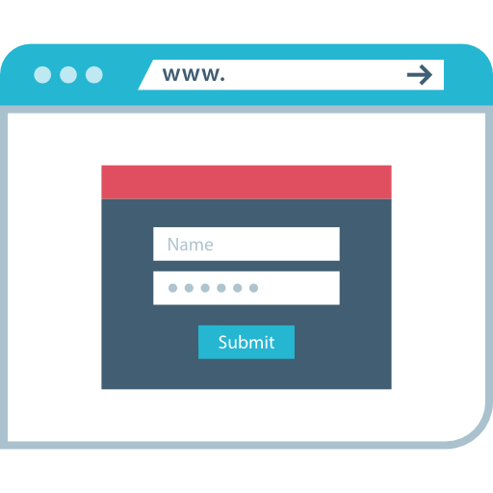

Employer
Register
via sms or Kwelyo website
Verify your registration
Call/text your desired worker
Notes:
*-hanap assets/pictures
>-next slide
5 mins
2 mins intro
Do I start with a great Philippines?
Statistics/Demographics
GDP???
Poverty index
>
*State ng education ng Philippines
*Only bla bla can go to school
*Only bla bla can finish high school
*Only bla bla can even go to college
>
*Paano na yung mga natira?
Sadly, sila yung mga nagiging following:
Tubero, carpenter, gardener, home repair, raketeros
Driver for long car rides (province or smth), Mason, electrician, Poso negro, washing machine, car mechanic, wood worker, furniture,
Sa mga natira,
*Only bla bla has access to the internet
>
*So what can we do for our lesser privileged brothers and sisters?
Show that education system is faulty at best, so habang inaayos pa yun, what we can do, right now is:
*To provide job opportunities to our lesser privileged brothers and sisters, especially those that have limited internet access or does not have access to the internet at all
*What comprises a nation? Nation building, building a nation (Dapat inclusive!!!)
2 mins demo
>1 min employer
>1 min worker walk through
Emphasize the solution being SMS based, very useful kahit wala/limited internet access yung worker
1 min
Isip tagline for nation building as closure. Tone of ending should be hopeful/empowering. Hopeful for a greater Philippines.
Nation building
Inclusiveness
Empowerment

Slide 25
DEMO
Notes:
*-hanap assets/pictures
>-next slide
5 mins
2 mins intro
Do I start with a great Philippines?
Statistics/Demographics
GDP???
Poverty index
>
*State ng education ng Philippines
*Only bla bla can go to school
*Only bla bla can finish high school
*Only bla bla can even go to college
>
*Paano na yung mga natira?
Sadly, sila yung mga nagiging following:
Tubero, carpenter, gardener, home repair, raketeros
Driver for long car rides (province or smth), Mason, electrician, Poso negro, washing machine, car mechanic, wood worker, furniture,
Sa mga natira,
*Only bla bla has access to the internet
>
*So what can we do for our lesser privileged brothers and sisters?
Show that education system is faulty at best, so habang inaayos pa yun, what we can do, right now is:
*To provide job opportunities to our lesser privileged brothers and sisters, especially those that have limited internet access or does not have access to the internet at all
*What comprises a nation? Nation building, building a nation (Dapat inclusive!!!)
2 mins demo
>1 min employer
>1 min worker walk through
Emphasize the solution being SMS based, very useful kahit wala/limited internet access yung worker
1 min
Isip tagline for nation building as closure. Tone of ending should be hopeful/empowering. Hopeful for a greater Philippines.
Nation building
Inclusiveness
Empowerment

Slide 26
Leveraging technological innovations for building the nation
Inclusive
Empowering
Sustainable
Notes:
*-hanap assets/pictures
>-next slide
5 mins
2 mins intro
Do I start with a great Philippines?
Statistics/Demographics
GDP???
Poverty index
>
*State ng education ng Philippines
*Only bla bla can go to school
*Only bla bla can finish high school
*Only bla bla can even go to college
>
*Paano na yung mga natira?
Sadly, sila yung mga nagiging following:
Tubero, carpenter, gardener, home repair, raketeros
Driver for long car rides (province or smth), Mason, electrician, Poso negro, washing machine, car mechanic, wood worker, furniture,
Sa mga natira,
*Only bla bla has access to the internet
>
*So what can we do for our lesser privileged brothers and sisters?
Show that education system is faulty at best, so habang inaayos pa yun, what we can do, right now is:
*To provide job opportunities to our lesser privileged brothers and sisters, especially those that have limited internet access or does not have access to the internet at all
*What comprises a nation? Nation building, building a nation (Dapat inclusive!!!)
2 mins demo
>1 min employer
>1 min worker walk through
Emphasize the solution being SMS based, very useful kahit wala/limited internet access yung worker
1 min
Isip tagline for nation building as closure. Tone of ending should be hopeful/empowering. Hopeful for a greater Philippines.
Nation building
Inclusiveness
Empowerment

Slide 27
Questions? ☺
Notes:
*-hanap assets/pictures
>-next slide
5 mins
2 mins intro
Do I start with a great Philippines?
Statistics/Demographics
GDP???
Poverty index
>
*State ng education ng Philippines
*Only bla bla can go to school
*Only bla bla can finish high school
*Only bla bla can even go to college
>
*Paano na yung mga natira?
Sadly, sila yung mga nagiging following:
Tubero, carpenter, gardener, home repair, raketeros
Driver for long car rides (province or smth), Mason, electrician, Poso negro, washing machine, car mechanic, wood worker, furniture,
Sa mga natira,
*Only bla bla has access to the internet
>
*So what can we do for our lesser privileged brothers and sisters?
Show that education system is faulty at best, so habang inaayos pa yun, what we can do, right now is:
*To provide job opportunities to our lesser privileged brothers and sisters, especially those that have limited internet access or does not have access to the internet at all
*What comprises a nation? Nation building, building a nation (Dapat inclusive!!!)
2 mins demo
>1 min employer
>1 min worker walk through
Emphasize the solution being SMS based, very useful kahit wala/limited internet access yung worker
1 min
Isip tagline for nation building as closure. Tone of ending should be hopeful/empowering. Hopeful for a greater Philippines.
Nation building
Inclusiveness
Empowerment

